Slide 1

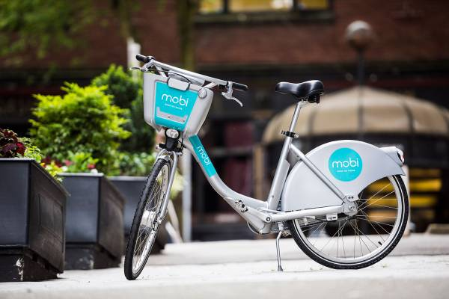
Bike Stations and businesses Statistical Modelling project Melissa Nielsen November 7, 2022

Slide 2
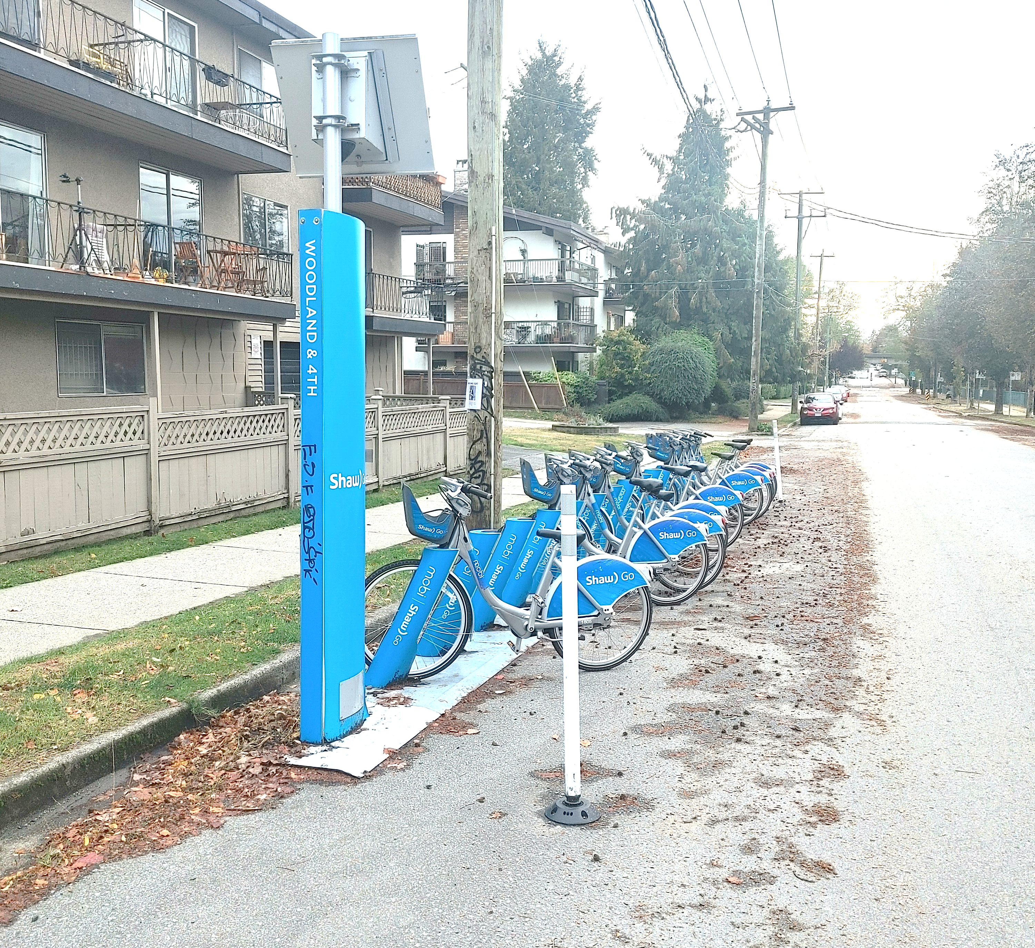
Project Overview
Get data from CityBikes API
Get data from Foursquare and Yelp APIs
Join data and create database
Create regression model

Slide 3
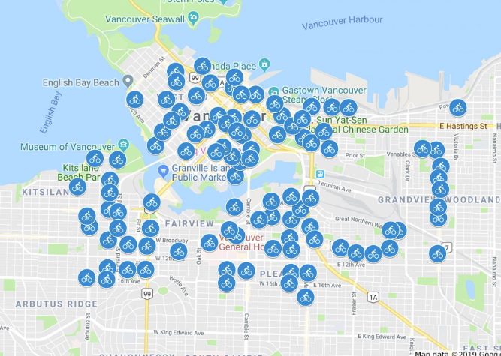
Project Scope
Looked at Mobi bikes in Vancouver, BC
Investigated following business types within 100 m of every bike station:
Bars
Restaurants

Slide 4
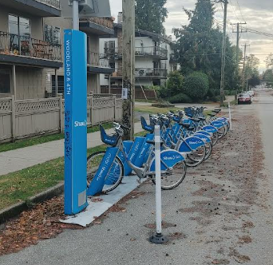
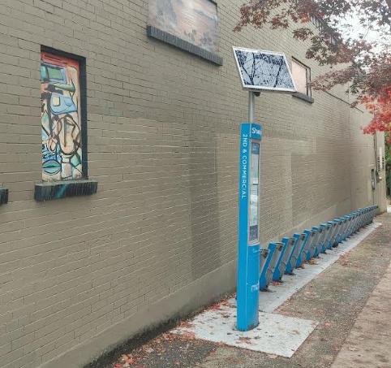
Key QuestionS
Are business attributes correlated with the proportion of available bikes?
Is the number of nearby bars and restaurants correlated with the proportion of available bikes?

Slide 5
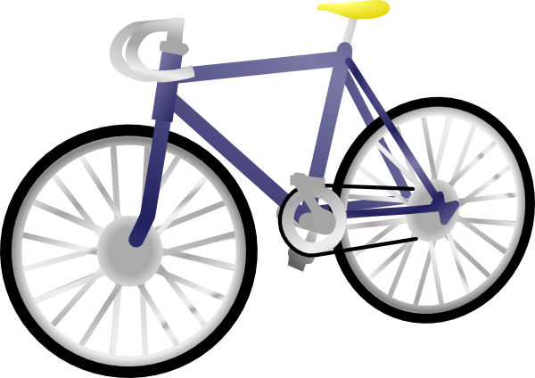
SteP 1: City Bike API
Parsed JSON file
Removed stations with status “offline”

Slide 6
Step 2: Get Data from Foursquare and Yelp APIs
Used requests.get() function
For each of the Yelp and Foursquare APIs, created the following:
Defined a function to use requests.get() with appropriate parameters
Used while loop to repeat for the latitude and longitude coordinates of every bike station
Used ‘glob’ package to read from all csvs into dataframe
Defined function to transform the JSON file into a dataframe and write to csv.

Slide 7

Step 2: Get Data from Foursquare and Yelp APIs
Used data from previous step to create 3 tables (for each Foursquare and Yelp):
Bike Station Table:
information about unique bike stations
key = station_id
Intermediary Table:
two columns only:
business id & bike station id
key = two above columns combined
Business Table:
information about unique businesses
key = business id (fsq_id for Foursqare and id for Yelp)

Slide 8
Step 2: Compare Results from foursquare and yelp
Yelp had more businesses, so used yelp data for further analysis

Slide 9
Step 3: joining and Exploring data
Combined Yelp and Citybike data using pd.merge
Since there was a ‘many-to-many’ relationship between bike stations and restaurants, used an intermediary table to join them.

Slide 10
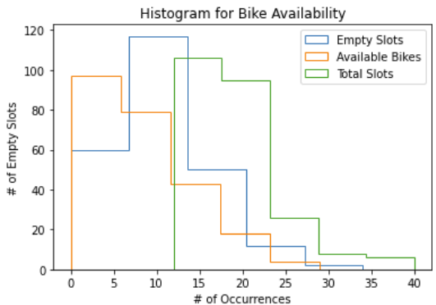
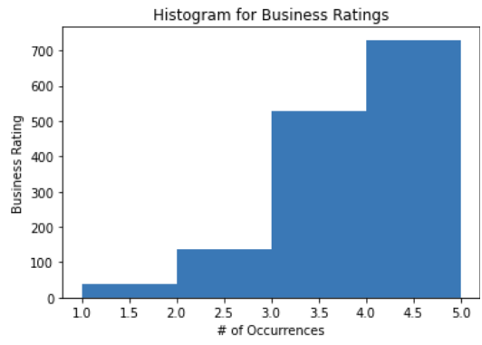
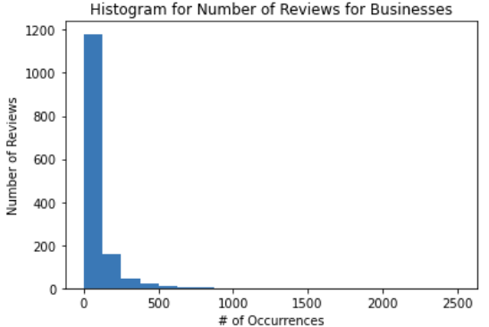
Step 3: Exploratory data analysis
Explored data using:
histograms
Data not normally distributed

Slide 11
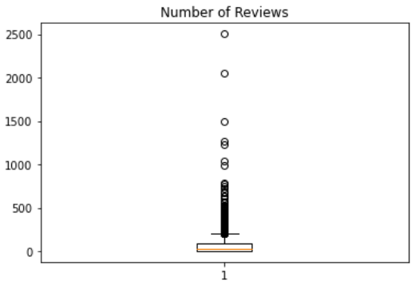
Step 3: joining and Exploring data
Explored data using:
boxlots
Many outliers!

Slide 12
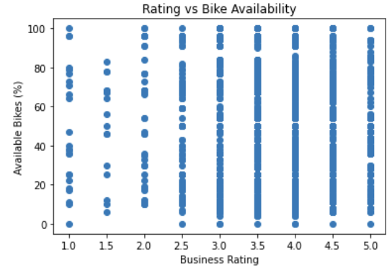
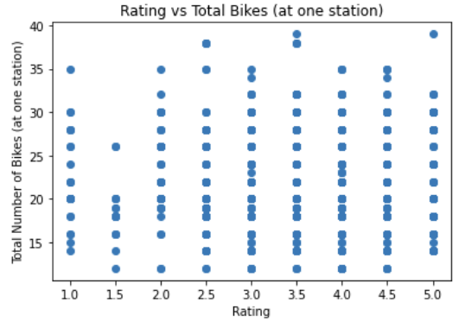
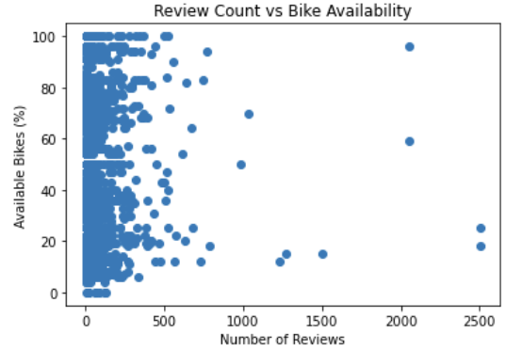
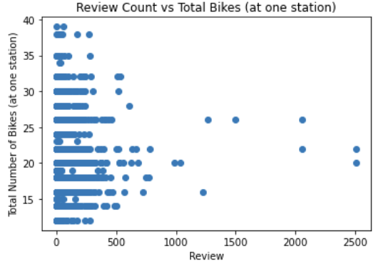
Step 3: joining and Exploring data
Explored data using:
scatter plots
No clear linear relationships

Slide 13
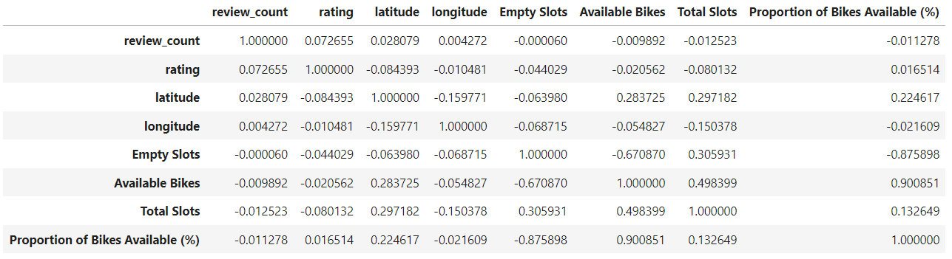
Step 3: joining and Exploring data
Explored data using:
correlation coefficients
Low correlation coefficients!

Slide 14
Initial Findings from EDA:
No correlation between business attributes an proportion of available bikes
No correlation between quantity of open businesses and proportion of available bikes

Slide 15
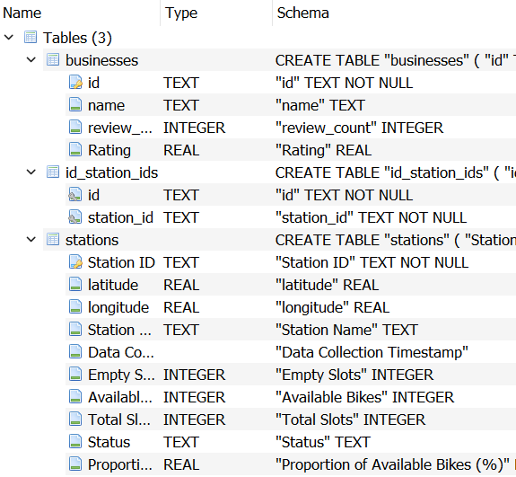
Step 3: Create SQLite Database
Businesses Table:
used ‘id’ (automatically assigned by Yelp) as primary key
Bike Stations Table:
Used “Station ID” as primary key
Intermediary Table (called ‘id_station_ids’:
id and station_id combined as key
id was foreign key linked to businesses table
station_id was foreign key linked to stations table
one-to-many relationship
one-to-many relationship

Slide 16
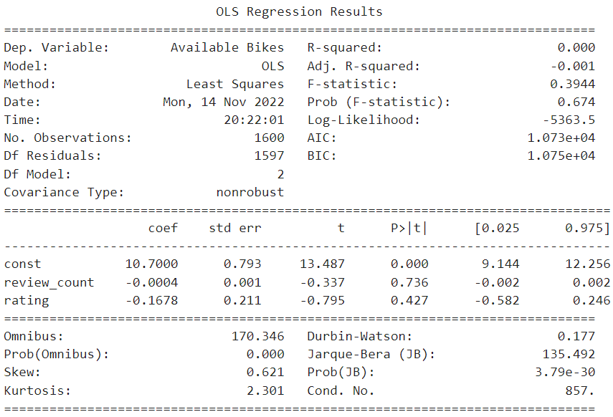
Step 4: Create Model
R-squared: 0.000
Model does not predict bike availability whatsoever
Model 1: number of available bikes as a function of attributes of nearby restaurants and bars?
Dependent variable is Available Proportion of Bikes (%)
Independent variables (x₁, x₂)
review_count
ratings

Slide 17
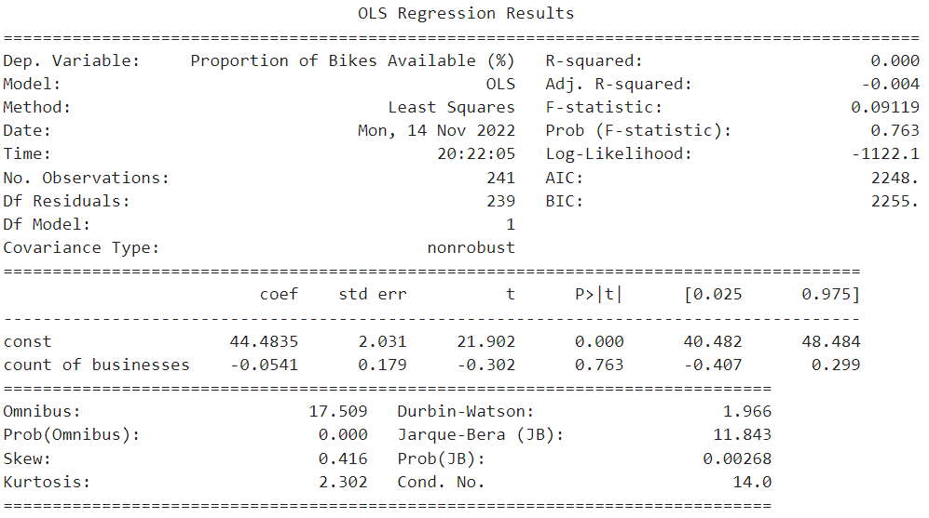
Step 4: Create Model
R-squared: 0.000
Model does not predict bike availability whatsoever
Model 2: number of available bikes as a function of count of nearby restaurants and bars?
Dependent variable is Available Proportion of Bikes (%)
Independent variables (x₁)
number of nearby businesses

Slide 18
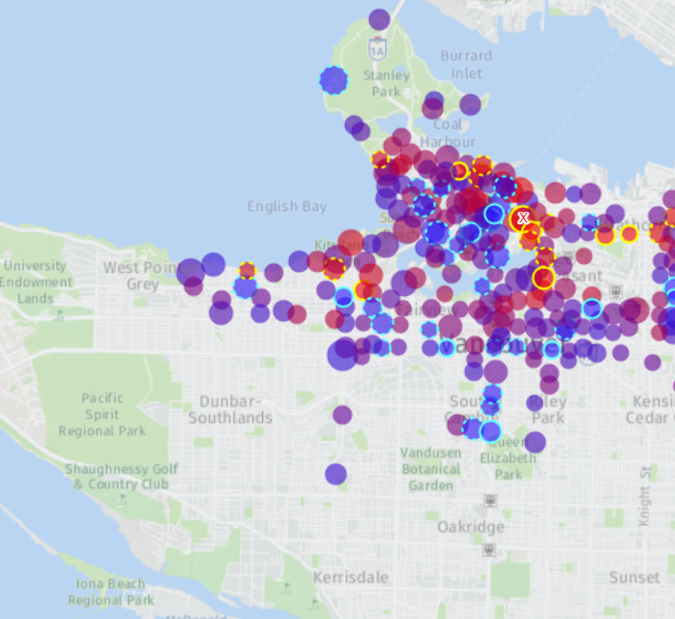
IF I HAD MORE TIME
See how open-ness affects availability of bikes by looking at bike availability at different times
Would look at density of total bikes, not just bikes per station

